Slide 1
PREVENTING
FAMILY VIOLENCE IN
POST SEPARATION
CO-PARENTING RELATIONSHIPS

Slide 2
WELCOME
Acknowledgements
Content warning
Workshop materials
This workshop is made possible by a grant from the Dept of Justice and Attorney General – Office for Women and Violence Prevention

Slide 3
Key points fOR today
Each case is unique
Understanding the dynamics of violence in each particular case is vital to preventing violence in the future
Collaboration between service providers can lead to better outcomes for families
Both victims and perpetrators need to be involved in a trauma informed way
Matters are often complex with many factors involved
Practitioner self-care is critical

Slide 4
Challenge to you - change how you think about the impacts of domestic violence.

Slide 5
Can/does psychological abuse and coercive control have a greater impact than physical abuse?

Slide 6
Is a person’s past trauma relevant to their experience of domestic violence?

Slide 7
Can a person’s experience of domestic violence impact their ability to give instructions or evidence in court?
(see FVBPP p16,17)

Slide 8
Can domestic violence impact a person’s parenting capacity? (s60CC(3)f FLA)

Slide 9
Can a mother’s
experience of emotional abuse and coercive control when pregnant, impact her unborn child?

Slide 10
Can a child’s experience of domestic violence have long term impacts on his/her physical and mental health throughout his/her lifetime?

Slide 11
Violence against women costs the economy $26 Billion per year, with victim survivors bearing about 50% of that: KPMG
“The Cost of violence against women and their children in Australia – Final report 2016”.

Slide 12
Among women 18-44 years, violence against women is the single biggest risk factor contributing to disease burden; more than smoking, drinking or obesity
(p17 National Plan to End Violence against Women and Children 2022 – 2032)

Slide 13
Points to remember: We won’t stop domestic violence, if we don’t first recognise that what we are seeing is domestic violence.

Slide 14
We won’t help someone heal from domestic violence, if we don’t first recognise the devastating impact that violence can have.

Slide 15
Points to remember con’t… Many of the adults involved in court proceedings were once children experiencing domestic violence, abuse or other adverse experiences in the households and communities where they grew up. (See workshop materials for potential impacts of this on a child’s development and future relationships)

Slide 16
In summary – Recognising * The behaviour or pattern of behaviour; * The underlying reason for the behaviour (& noting different types of behaviour can have different underlying causes); and * The harmful effect of the behaviour, Are all crucial to preventing domestic violence into the future.

Slide 17
The NDFVBB notes that “Each case of domestic and family violence involves a unique and complex series of facts that must be considered as a whole in order to understand the victim’s experience of violence, and to respond appropriately to risk of future violence and perpetrator accountability. Making assumptions about parties’ motivations and behaviours, or attempting to categorise violence according to severity or parties’ general circumstances may result in a misunderstanding of the dynamics of violence in a particular case and inappropriate responses to the needs of the victim and perpetrator.

Slide 18
Victims of domestic and family violence may sustain long-term harm to their physical, mental or emotional wellbeing. Whilst they may obtain legal protection from future harm, it may take years of treatment and counselling to recover from the … violence.” “In many cases victims described the cumulative daily emotional psychological abuse as having a more debilitating effect on their self-esteem and ability to cope with situations than the physical violence they also experienced. Participants also report that threats of violence can be as effective as actual violence for the control…. they exercise and fear they induce, often preventing the victim from leaving the abusive relationship.” (p550)

Slide 19
cf FVBPP pp 19,20 assessment of risk – * how extreme was the violence? Potency, pattern (was there physical violence?) * Primary perpetrator (who provides a more plausible account – but what if victim is impacted by trauma?). * See also p24 re categorisation of violence and relevant factors to consider on p25. * Courts currently look at extent of risk behaviour posed to the child (p26). * Family Law Amendment Bill 2023 proposes amending s60CC so that factors to consider would include risk to a person who has care of a child, as well as just the child

Slide 20
FVBPP – points to note * No requirement fear experienced by victim is reasonable (not always applied in practice). * Notions of propensity and seriousness still have a focus on physical harm. The seriousness of coercive control and its risks are often underestimated. * Victims are often traumatised and vulnerable witnesses and find it difficult to give evidence on their own behalf or appear credible.

Slide 21
Let’s consider some different types of domestic violence (see handout)

Slide 22
Continuation of coercive control through dispute resolution and family law proceedings

Slide 23
A good resource on how coercive control can continue post separation - “Coercive control in children’s and mothers’ lives” by Emma Katz 2022

Slide 24
Common continuing behaviour * undermining of other parent * Financial control, * psychological abuse, * gaslighting, * entitlement, * distortion of the truth (can be very subtle)

Slide 25
Common continuing behaviour * manipulativeness (eg behaving in interviews and when other people present but not at other times) – texts messages can be telling. * contradictory statements and behaviour * externalisation of responsibility * denial, minimisation, victim blaming * treating children like an extension of themselves * intimidation (used to occur through cross-examination but note now s102NA –FLA: Prohibition of cross examination of a party where allegations of family violence)

Slide 26
Multifaceted Risk of Family Violence – M v M (Mullane J) “The father’s abusive behaviour presents a multifaceted danger for the children. There is a risk of violence to them personally... There is a risk that violence poses when it involves living with fear, insecurity and vigilance. There is the danger of ongoing fear that the father will emotionally or physically, abuse the mother they love. There is the danger that E will learn from the father’s abusive behaviour that abuse is part of life for females and become even more accepting of such behaviour. There is a danger that both children will come to believe from the father’s abuse of the mother, that women are lesser beings..

Slide 27
Multifaceted Risk of Family Violence – M v M (Mullane J) con’t But the greatest danger is that B, particularly, will learn from his father’s behaviour that physical and emotional abuse are acceptable ways of dealing with other persons and thus come to share his father’s disability. Such a disability will mar his dealings and relationships with others, including those he loves, bring him into conflict with the police, the Courts and the community, and result in him being penalised and even being imprisoned”.

Slide 28
Detection of Risk - Lighthouse Project This is a project by the courts to screen for risk with a primary focus on improving outcomes for families involved in the family law system. A questionnaire completed by parties is used to assess risk and to manage the case according to the risk reported by the parties. The risk screen is based on Family DOORS (Detection of overall risk screen: https://familydoors.com/) but it is a more summarised form. DOORS is based on the belief that engagement must occur not only with victims but also with potential or actual perpetrators in order to prevent the escalation of violence.

Slide 29
P70 – Perpetrators of violence have often experienced historical incidences of victimisation themselves, which does not justify or excuse their behaviour but nonetheless in the current context of loss and separation, may lead them to act unsafely, or report that they have already acted unsafely. De-escalating stress and offering support in these cases may be crucial steps in preventing future harm. Increasing isolation through blaming, shaming, or cold referrals so silo services (e.g for anger management) without any other practitioner intervention may increase the likelihood of further and intensified violence.

Slide 30
DOORS Con’t… DOORS considers both historical risk and protective factors as well as recent risk and protective factors.

Slide 31
Historical risk/ protective factors include (p5): * Family of origin history of violence and abuse and other prior trauma and its resolution; * Mental health and personality functioning; * Social/anti-social criminal behaviours; * Impulse control/ego maturity; * History of relationship loss; * Nature of parents’ relationship, including during pregnancy; * Parenting attunement / sensitivity; * Education; * Social support/ isolation; * Cultural and ATSI factors that escalate or de-escalate risk; and * Disability issues.

Slide 32
Recent risk and protective factors include (p5): * Meaning of the separation to each family member * Coping and resolution re the separation experience * Nature of post separation dispute * Management of parental conflict * Power balances * Escalating vs de-escalating social influences (e.g new partners, nature of legal process) * Current mental health * Parenting quality; responsiveness to children * Current capacity to reflect and take responsibility

Slide 33
Family Law Courts have introduced the “Evatt List” for high risk matters. https://www.fcfcoa.gov.au/fl/lighthouse/evatt * Matters where at least one person has completed screening through the Family DOORS triage screening process and returned as high risk * one judge one family model * prioritise matters where there is high risk * cases are closely case managed

Slide 34
Helpful Services – You may wish to consider these where there are allegations of DV * Behaviour change programs * Anger management programs * Substance abuse programs/ courses * parenting courses (POP, circle of security) * trauma counselling where needed There is still a need to ensure any service suggested will target the cause or dynamics underlying the poor behaviour. Collaboration and integration can be key. (eg Evan Stark “Coercive Control – how men entrap women in persona life” 2007 p73 – Stark gives an example of how Carl could get what he wanted from Joanne without resorting to [physical] violence. “Carl’s quiet rage was even more intimidating than his assaults. Only now , she was isolated as well and had neither a name for nor the space to explore her feelings of entrapment”.

Slide 35
EXPECTATIONS OF LITIGANTS IN COURT MATTERS * A domestic violence order will stop domestic violence (and police will prosecute when a person continues coercive and controlling behaviour) * Courts and single experts have a good understanding of coercive control and can recognise it when it occurs in relationships * Perpetrators will be held accountable for their actions * The court process will not cause them further trauma and be part of the “victim blaming” process

Slide 36
REALITY FOR LITIGANTS IN COURT MATTERS * Recalling details of the abuse they have experienced (particularly when they have tried to forget it) can be extremely difficult. Unresolved trauma may make victims appear less credible. * Many DV victims do not get assistance from police in prosecuting domestic violence matters. * Legal fees can be an added cause of stress and are a serious impediment to victims proceeding with private DV applications. * Many victims struggle with the emotional energy and time required to prepare court material. * Understanding the specificity required for court affidavits is difficult for parties when they are not legally represented.

Slide 37
Expectation of Decision Makers Decision makers in family law matters require parents to demonstrate capacity for emotional insight, intelligence, common sense, be compassionate for the other parent and focus on the needs of the children.

Slide 38
In reality, how many clients who are suffering the impacts of domestic violence or trauma, have this capacity?

Slide 39
Many clients who have experienced DV are trying to regain or develop their sense of empowerment, sense of self and decision making capacity. Court proceedings are often counter productive to this.

Slide 40
The National Domestic and Family Violence Bench Book (NDFVBB): “Many people who are victims and perpetrators of domestic and family violence have experienced trauma. Our studies have indicated that people involved with the Criminal Justice System have higher rates of personal histories of trauma….If underlying trauma is unresolved, it may cause ongoing adverse effects which may not necessarily be apparent and may include the inability to:

Slide 41
* Cope with normal stresses and strains of daily living; * Trust and benefit from relationships; * Manage cognitive processes, such as memory, attention and thinking; * Regulate behaviour; or * Control the expression of emotions.”

Slide 42
Role of the Independent Children’s Lawyer

Slide 43
Impacts of DV, Chronic Stress and Trauma (including cumulative trauma) on Health and Wellbeing (see further material in workshop handouts and Fact sheet https://www.communityservices.act.gov.au/domestic-and-family-violence-support/what-is-act-government-doing/dfv-risk-assessment/fact-sheets/impacts-of-domestic-and-family-violence-on-women)

Slide 44
Other impacts of DFV and chronic stress you might not know about….

Slide 45
Accelerated aging and epigenetic changes caused by domestic violence and toxic stress

Slide 47
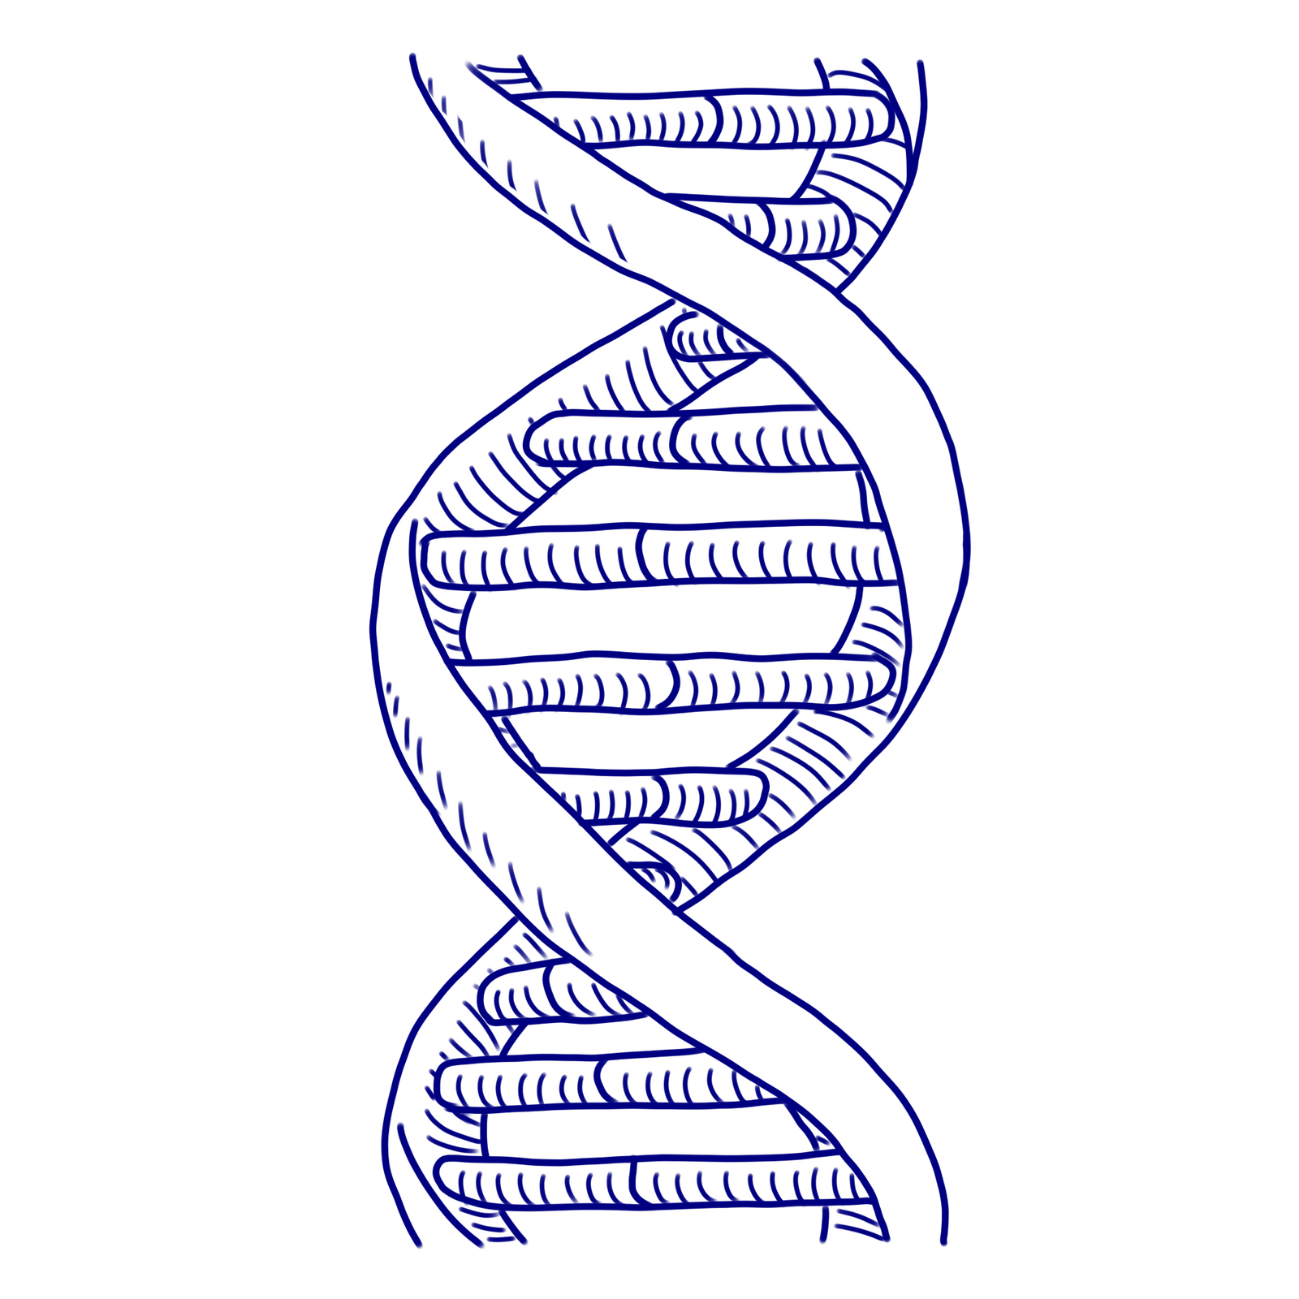
Some helpful terms to understand:
Genetics
Your DNA Code
Epigenetics
How your genes are expressed (i.e. get turned up or down, or turned completely on or off)

Slide 48
Toxic stress can damage your DNA and cause accelerated aging

Slide 49
Some people are more vulnerable to toxic stress because of their genetic make up

Slide 50
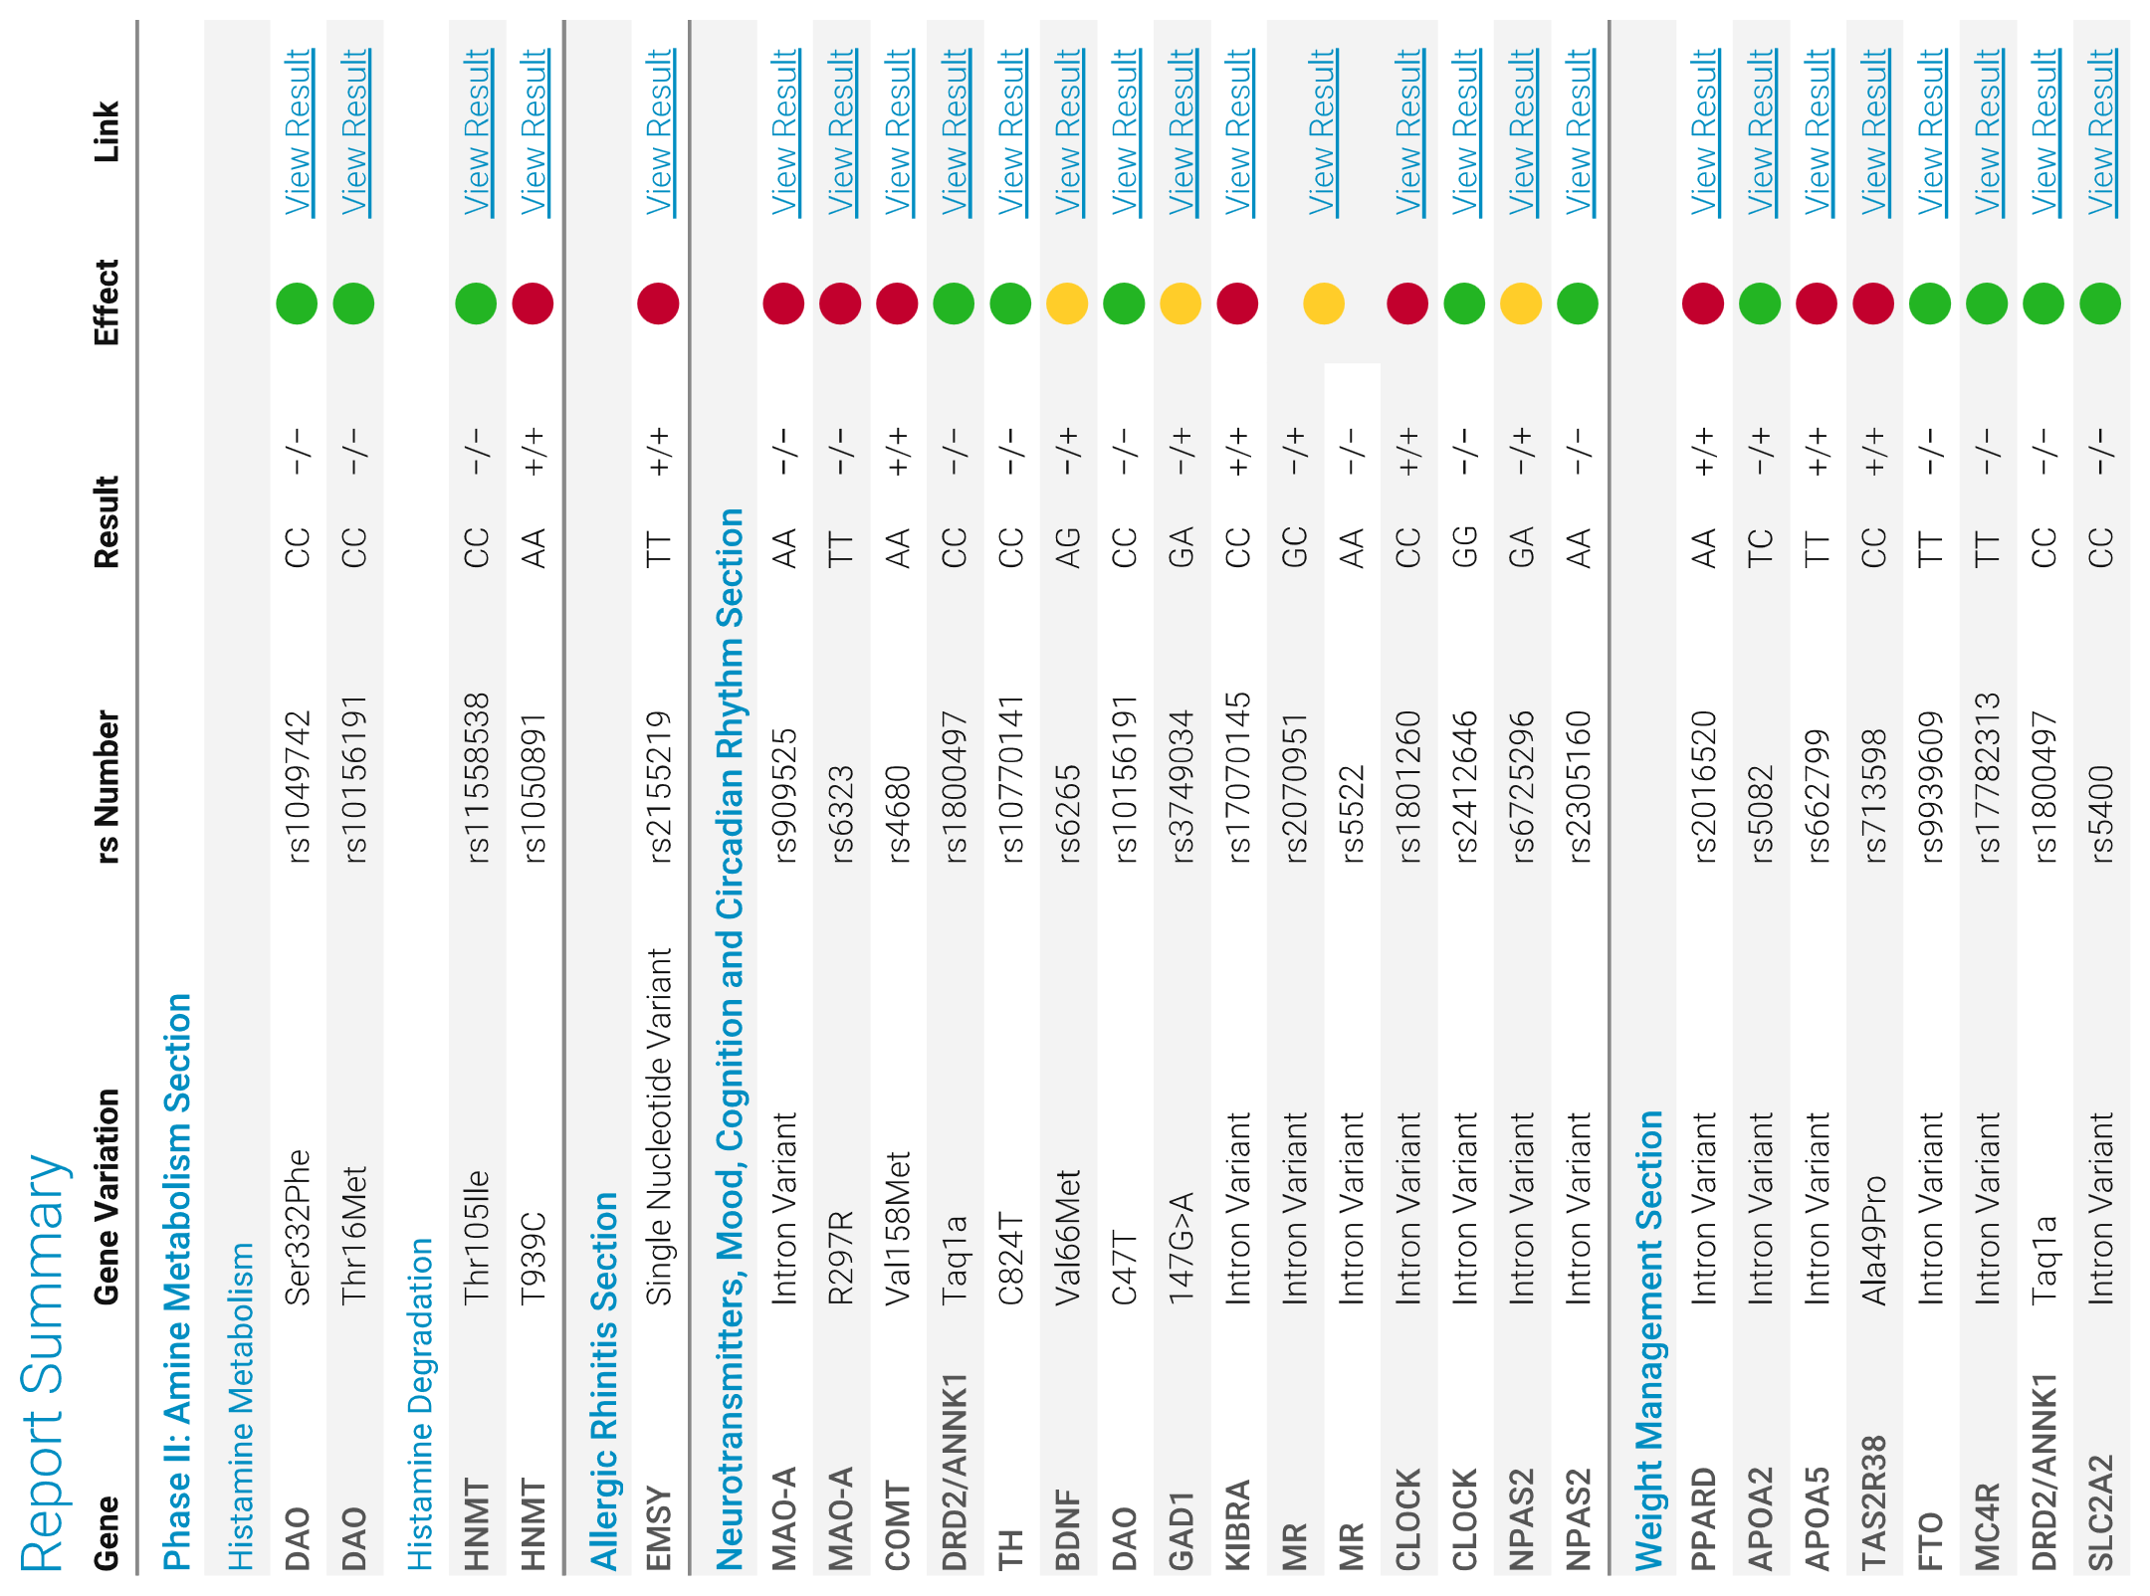
What does a Genomic Test Look like?

Slide 51
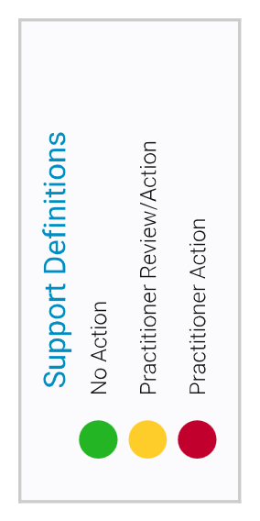
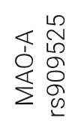
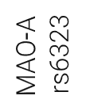
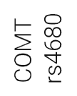

Slide 52
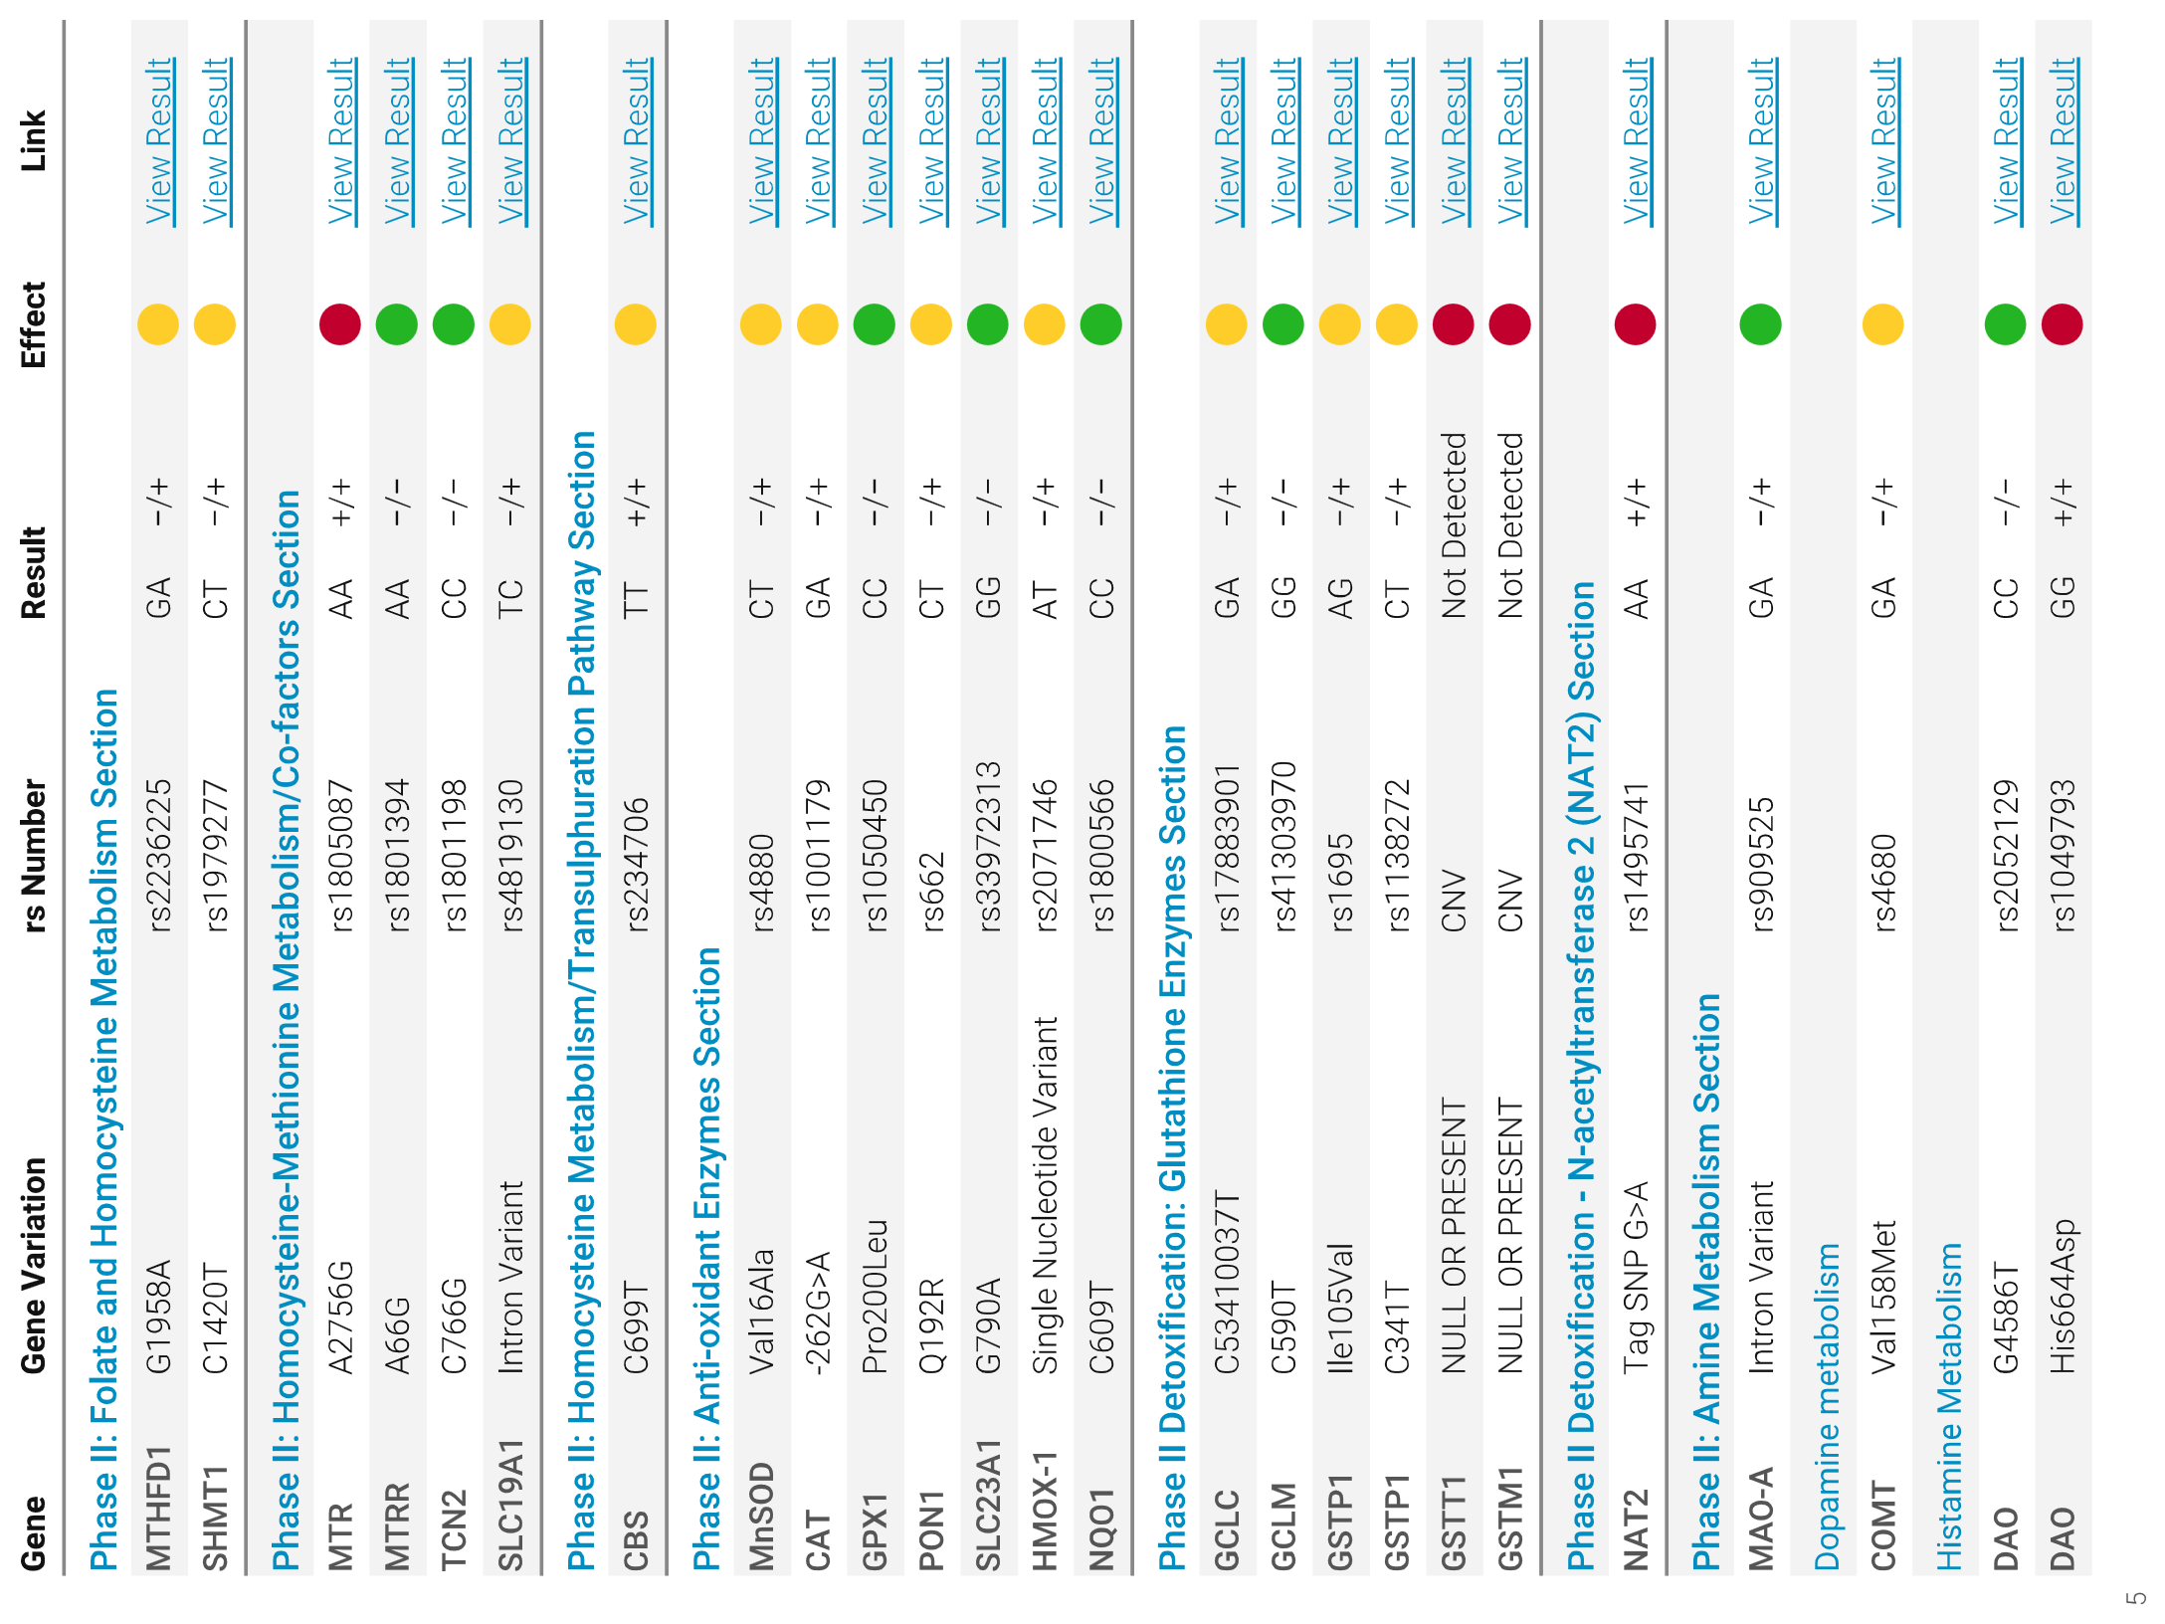
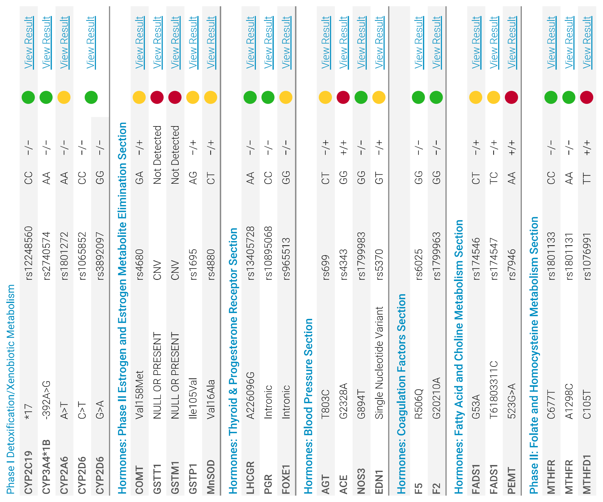

Slide 53
If we want better results for families,
treatment has to be personalised to them.

Slide 54
Precision medicine – How can it help clients who have experienced chronic stress?
(see handout in workshop material)

Slide 55
“In universal standard health care” the treatment that most commonly works is tried first, although it may prove unsafe or ineffective for an individual patient…

Slide 56
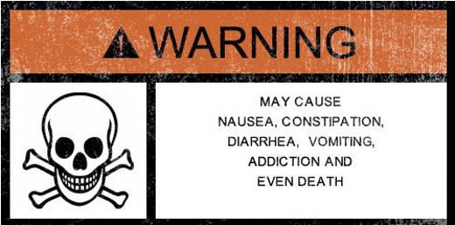

Slide 57
“The great promise of the 21st century is the transition from universal standard care to universal precision care…”: Office of the Chief Scientist – Occasional paper, October 2018 “Precision Medicine” (p3)

Slide 58
LUNCH

Slide 59
Strategies to prevent DFV and assist victims

Slide 60
Address the dynamics of family violence
(Safe & Secure – 2013 p 34) including:
A personal belief system that legitimizes the use of violence as a form of relational power
Undiagnosed or untreated mental health problems;
Alcohol or drug addictions;
A lack of social support;
Inability to manage personal stressors;
Unprocessed childhood experiences of trauma; and
Dislocation from cultural identity.

Slide 61
Tips when working with clients with a dysregulated stress response
Recognise the limitations your client has. Don’t keep trying to get information from client if he/she is not capable of providing it
Provide education about definition and impacts of family violence and toxic stress. (Acknowledge that avoidance is often used as a coping mechanism)
Reduce options to writing and hand to client

Slide 62
Tips con’t
4. Make referrals to other service providers as appropriate. (It can help this includes a statement you have prepared about client’s experiences)
5. Work out what external evidence might be available and start collecting this. You want to get as much as possible to piece the jigsaw together
6. Do a detailed working chronology and add to it over time as you get more evidence. When appropriate go over the chronology with the client.
7. Validate their experiences/ emotions (not necessary their behaviour)

Slide 63
Case Studies – Final words

